Slide 1
Northwind Distributor
Data-driven decision making
Suong Hoang, Data analyst, Dec 2024

Slide 2
PRESENTATION AGENDA
1
Overview
2
Objective
3
Analysis
4
Summary

Slide 3
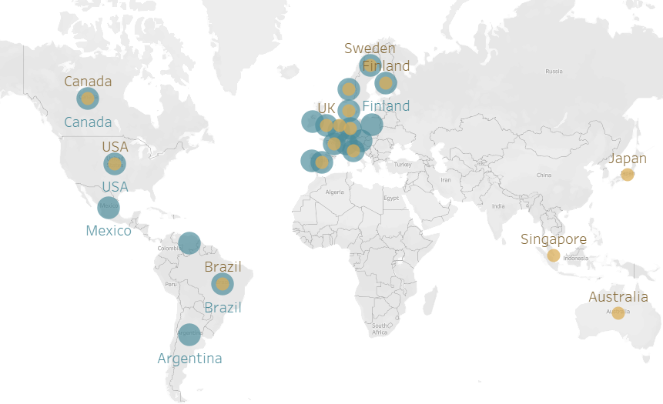
Overview
Business type: Wholesale distributor B2B
Customers: Groceries stores, Supermarkets, Restaurants,…
91 customers came from 21 different countries
29 suppliers from 16 different
Business Model: Buying from suppliers, marking up the price, and selling to B2B customers
77 products fall into 8 categories
9 employees
Selling platform: Online
Analysis time frame: Jun 96 to Apr 98 *
Cost assumption: Freight is carried by the company
Customer’s countries
Supplier’s countries
* Data of May 98 is incomplete

Slide 4
Objective
To present key findings and actionable recommendations that will enhance the company’s profits by focusing on:
Strengthening customer relationships
Delivering high-quality products promptly
Achieving sustainable growth

Slide 5
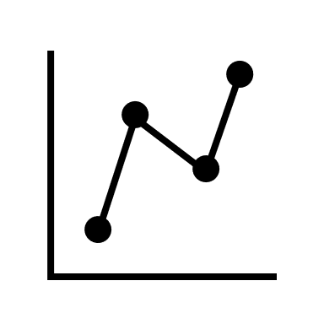



Analysis | Areas
SALE KPI
What is the performance of revenue and profit over time?
What are the top categories? Top countries?
Does company generate a profit with every dollar of revenue it earns??
CUSTOMERS
How active are the customers? What is their order value? How often did they order
Who are the top customers? % of them? % revenue contribution?
PRODUCTS
What are the top & bottom performers? Their status? Trend? Ranking?
What are the price ranges? What is the most popular range? and contribution to total revenue?
STOCK
What is the actual stock level? Does it meet the demand quantity?
Does the current reorder point a good indicator for inventory management to avoid sales loss or storage damaging?

Slide 6
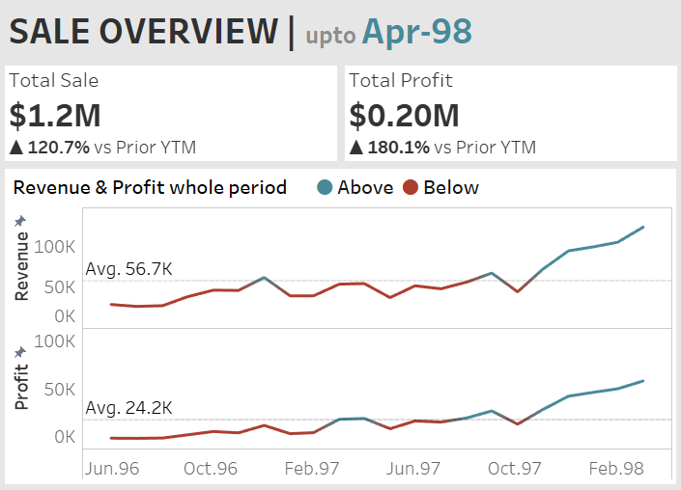
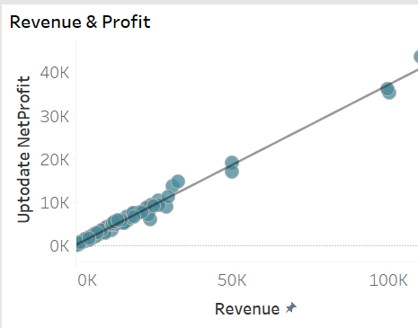

Analysis | Sale Performance
Sale & Profit have almost identical trend patterns: consistency of profit margin
Significant upward trends accelerated to a steep incline from December 1997 and peaked in Apr 98.
Top 3 category contributed to > 50% : Beverage, Dairy, Confection
Top 3 Countries: USA, Germany, Austria contributed for 47% Rev
Austria at #3 only with 2 customers: crucially important
Every $ increase in Sales, Net Profit increased by 37 cents

Slide 7
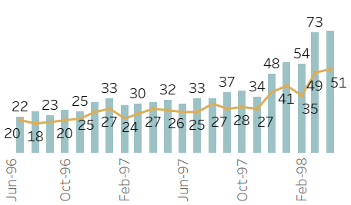
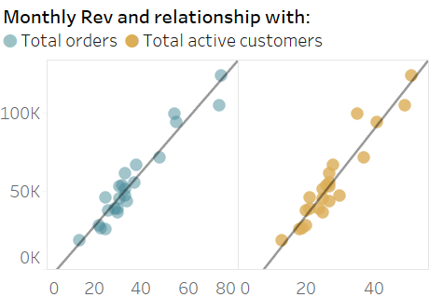
Analysis | Customers | 1
Finding
Upward trends for total orders and total active customers across the data time frame
Both metrics show significant positive correlations with total monthly revenue.
As the number of orders or the number of active customers increases, monthly revenue increase
Recommendation
Regularly communicate with customers through newsletters or updates on new products and offers to maintain relationships with existing customers
Expanding market, acquiring new customers

Slide 8
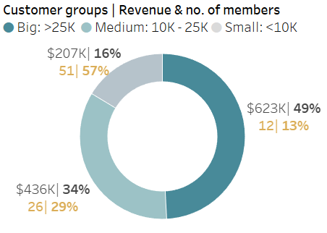
Analysis | Customers | 2
50% of total revenue is generated from a 13% customer base.
A small segment of customers is responsible for a substantial portion of our income.
Pros: Opportunity for Growth by expanding customer base and increasing sales among a broader audience.
Cons: High dependency Potential risks of overall sale performance impact due to high dependency
Recommendation
Nurturing the relationships to ensure sustained revenue generation: by Loyalty programs, assigning specific account managers, priority during high season, long-term buying contracts, competitive price

Slide 9
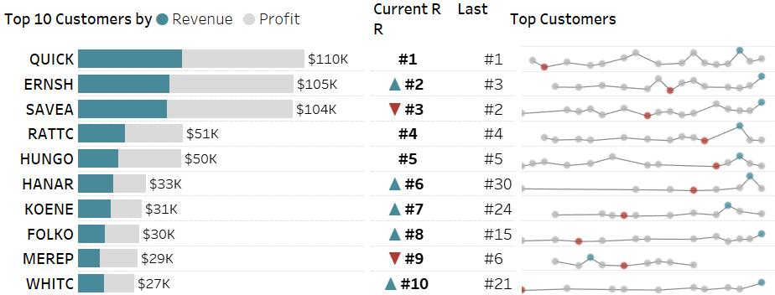
Analysis | Customers | 3
Finding
Top 5 are stable with their rank over time (except with minor differences for #2 and #3)
MEREP dropped in rank and also stopped orders from Oct 1997
New rising stars: HANAR, KOENE, FOLKO, WHITC
Recommendation
Contact MEREP to understand why did she stop to order
Investigating #6 to #10 of the last rank? Why did they drop in rank
Offering new rising stars loyalty program & benefit

Slide 10
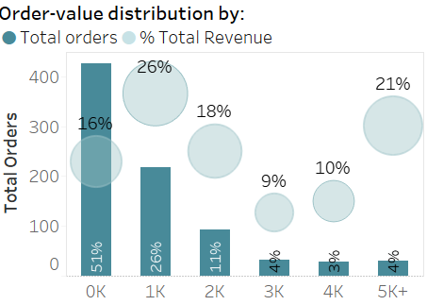
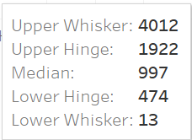
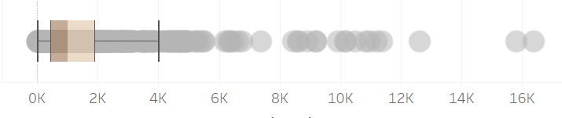
Analysis | Customers | 4
Findings
50% of total orders are less than 1k but accounted for only 16% of revenue
Large orders above 3k : 11% orders accounted for 40% of the revenue
Orders < 200$ accounted for 10% (*)total orders (10%handling cost) but only contributed to <1% revenue
Recommendation
Encouraging customers to order higher volume by offering volume-based discounts
Offering free shipping with the condition of Minimum order value
Introducing a minimum order threshold of 200$ gradually and flexibly to different groups of customers

Slide 11
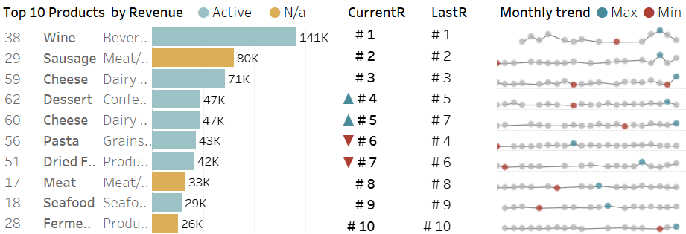
Analysis | Product | 1
Finding
Stable ranking over time: Good quality
Active status: 3 out of the top 10 products were decided not to continue which will have a significant negative impact on revenue as well as relationships with customers who have a high purchased volume of them
Recommendation
Reconsidering to continue with those key products
Maintaining efficient stock levels to avoid sale loss associated with understocking

Slide 12
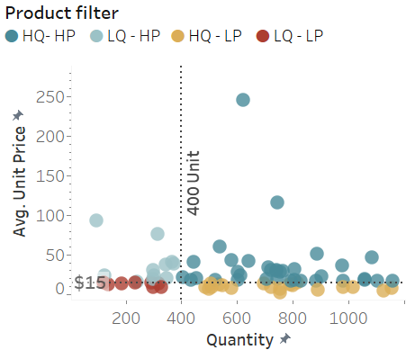
Analysis | Product | 2
HP-LP
HQ-HP
Targeting specific customers who are likely to buy premium products: restaurants, hotel
Volume discount
Quantity-based loyalty program
Leverage purchasing power in front of the supplier with big quantity order
Buddling with other products to increase overall sale
LQ - LP
HQ - LP
Clearing out the current stock with a maximum discount
Eliminating this group from the product list
Quantity-base discount
Negotiating with suppliers to reduce unit cost
Giving higher discounts even getting a lower margin

Slide 13
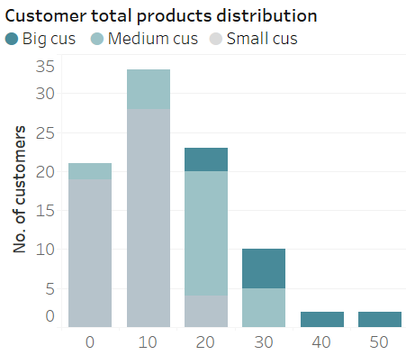
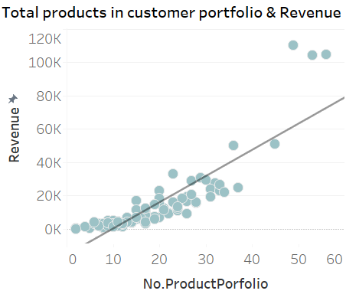

Analysis | Product | 3
Most customers have less than 20 products on their shopping list
Big customers have more products on their list
Customers who have more numbers of products tend to buy more in total
Recommendation: Introducing new products to the existing customers

Slide 14
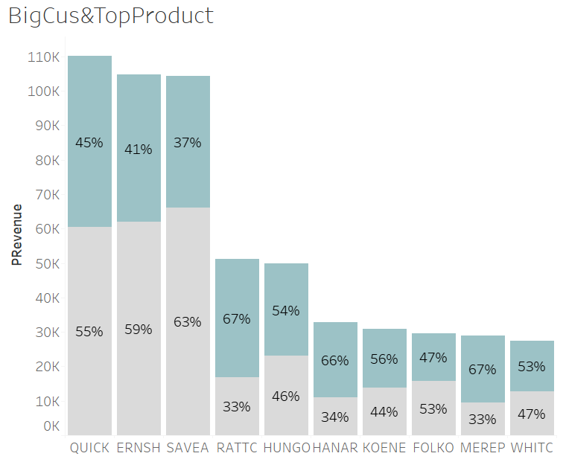
Analysis | Top products & Top customers
Top customers are most interested in the top products
Indicating that these are important products for their business as well
Recommendation: Keeping good stock management to supply to the customer on time since they are important products to them as well
Revenue from the top 10
Revenue of the rest

Slide 15
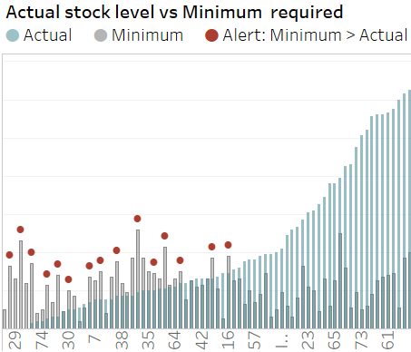
Analysis | Stock | 1
Finding
Many products have stock levels lower than the minimum quantity required: causing potential loss of sale due to understock, especially for the top-selling
At the same time, many are overstocked, causing storage costs, loss due to expired stock, and cash flow issues…
The current reorder point (ROP) set by the company is not a good indicator of managing stock level: too high, too low, at 0
9 of of 10 top products (check next slide) with ROP at 0 (meaning only reorder when they are run out of stock): very risky
Recommendation
Resetting ROP to “Minimum required” as recommended and making orders for the red alert asap
Stock Clearance promotion for the overstock items
Product ID
Minimum required (ROP)*:
= Daily volume * Order lead time from supplier + Safety stock
Estimated lead time = 20 days including shipping
Safety stock = adding 10%
*Reference for ROP calculation: link

Slide 16
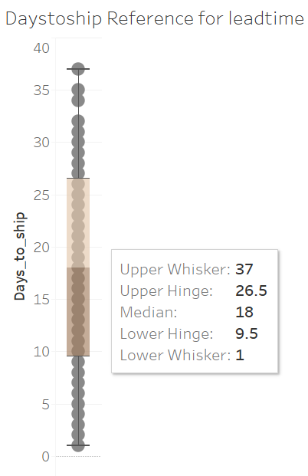
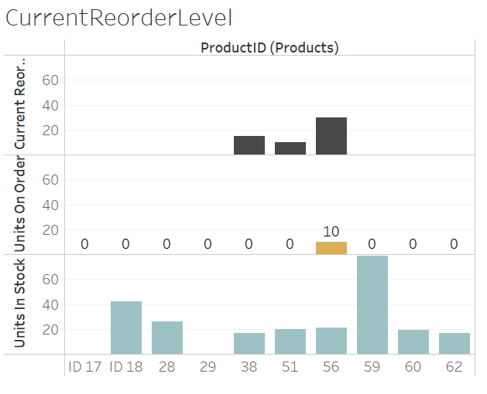
Analysis | Stock | 2
CURRENT REORDER LEVEL, AVAILABLE STOCK,
UNITS ON ORDER OF TOP-SELLING

Slide 17
Summary
IMMEDIATE ACTIONS TO IMPLEMENT
Restock best-selling items currently out of stock or low in inventory to avoid sales loss
Reactivate key product IDs 29, 17, and 28, previously in the top 10, to the product lineup.
Investigate why MEREP ceased orders and restore the relationship
Examine customers previously ranked #6 to #10 to identify reasons for their decreased rankings.
Update Inventory Strategies: Establish a new reorder point (ROP) system for improved inventory management.
Clear Overstock: Launch a stock clearance promotion to manage overstocked items efficiently.

Slide 18
Summary
STRATEGIC RECOMMENDATION
Focusing intensively on the top customers with loyalty programs, contracting, personalized account manager
At the same time engaging and developing relationships with the remaining customers to encourage them to order more
Separating shipping cost from product pricing to make them appear more competitive and to be more flexible with the different offerings to different customers/products
Offering free shipping with the condition of Minimum order value to encourage larger order
Introducing a minimum order threshold of 200$ gradually and flexibly to different groups of customers
Regularly communicate with customers through newsletters or updates on new products and offers to keep them engaged
Expanding market, acquiring new customers

Slide 19
Thank you!

Slide 20
Appendix
Tableau Dashboard Link:
https://public.tableau.com/app/profile/suong.hoang/viz/NorthwindProject_17313234121030/ProductDashboard?publish=yes
Tableau file for all detailed calculations, charts
https://drive.google.com/file/d/1-Lb3OExWmWd7yxFT4t3NirIiUfA5pave/view?usp=drive_link
SQL queries
https://github.com/ShugiSuong/northwind-wholesale/blob/main/SQLqueries.sql

